Slide 1

Business Gateway Growth Hub – Our Story
Peter Chandler, Head of Economic Regeneration,
Leicester City Council
Sue Tilley, Head of Business and Innovation,
Leicester and Leicestershire Enterprise Partnership

Slide 2
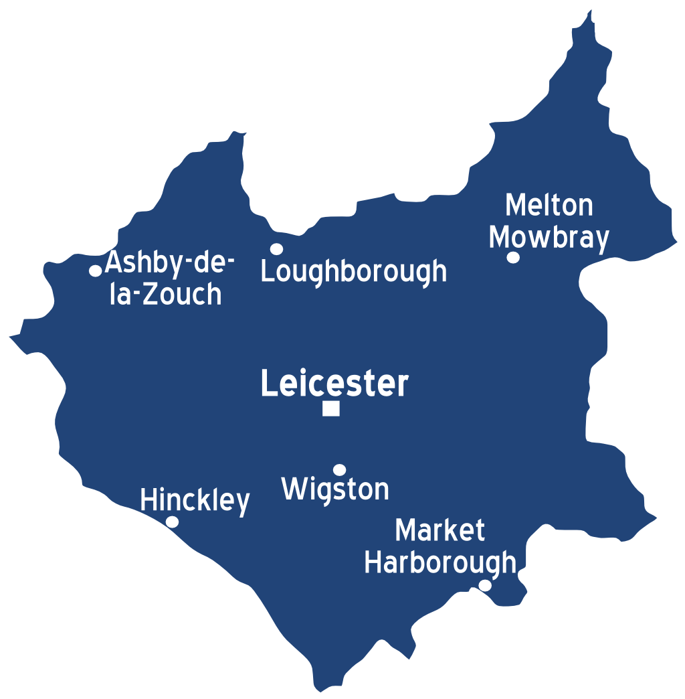
ERDF Project Overview
Subregional business support project
£5.9 million European grant
£2.2 million partner funding
January 2019 to June 2023
Free support service of the Business Gateway Growth Hub

Slide 3




Project Delivery Partners

Slide 4










Business Support Offer
Information
and signposting
Support
Programmes
Investment
readiness
Brexit readiness / COVID response
Business
advisers
Business
growth grants
High growth
support
Events
and workshops

Slide 5
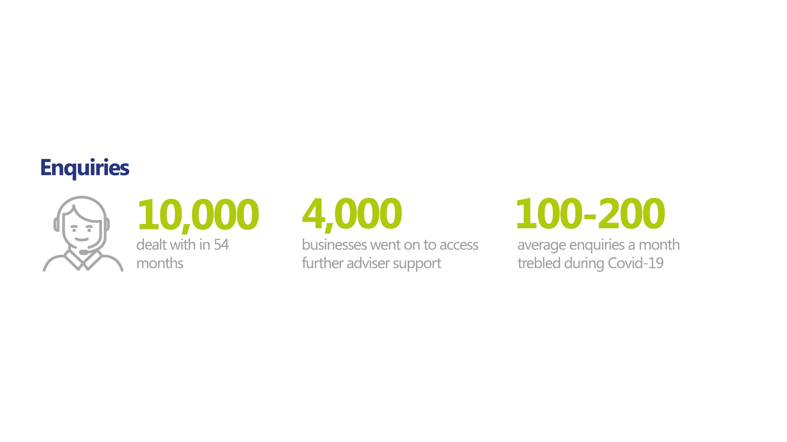
Key Statistics
Leicester and Leicestershire
44,000 businesses 98% SMEs
Enquiries

Slide 6




COVID-19
Rapid change to delivery – in person to online
Enquiries x3
Attendance at events x3
Significant interest in grants
More Health and Wellbeing events

Slide 7
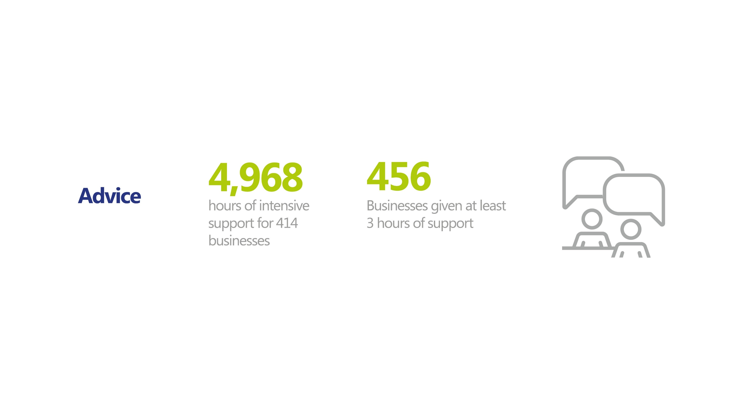
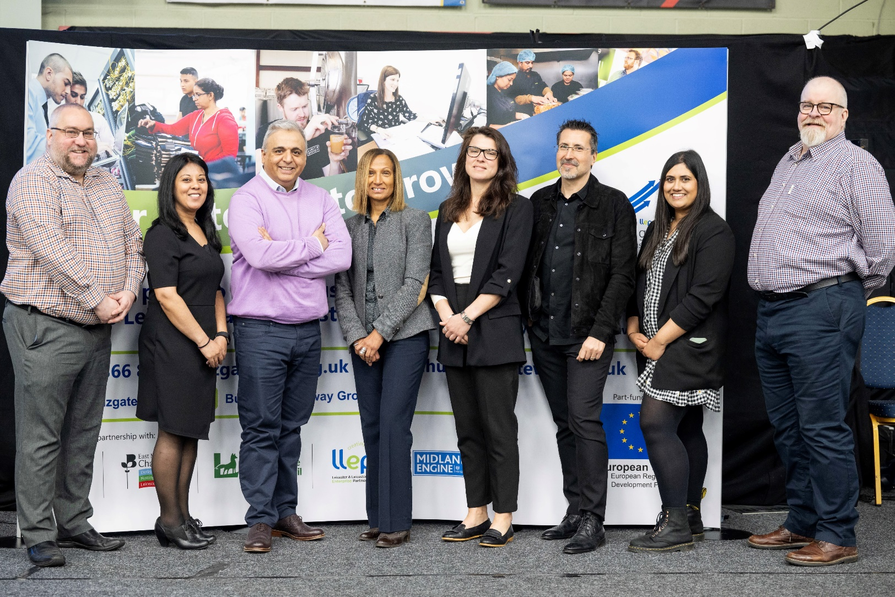
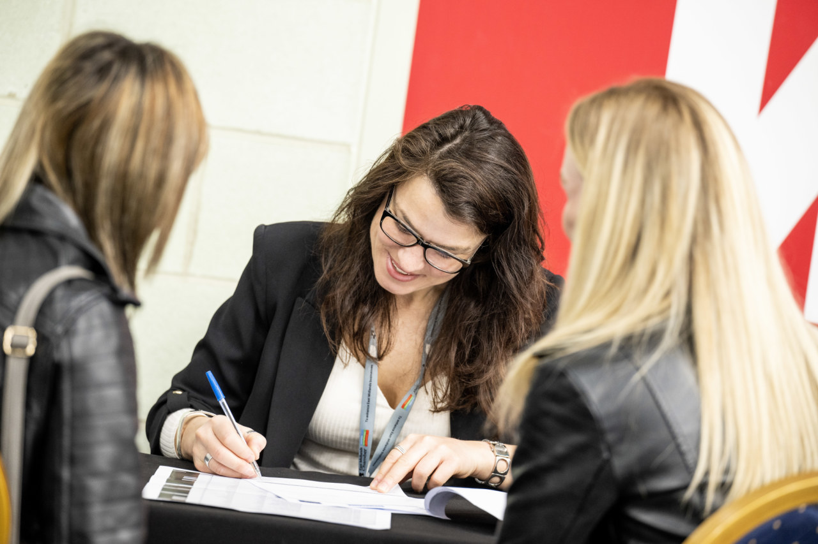
Advice

Slide 8
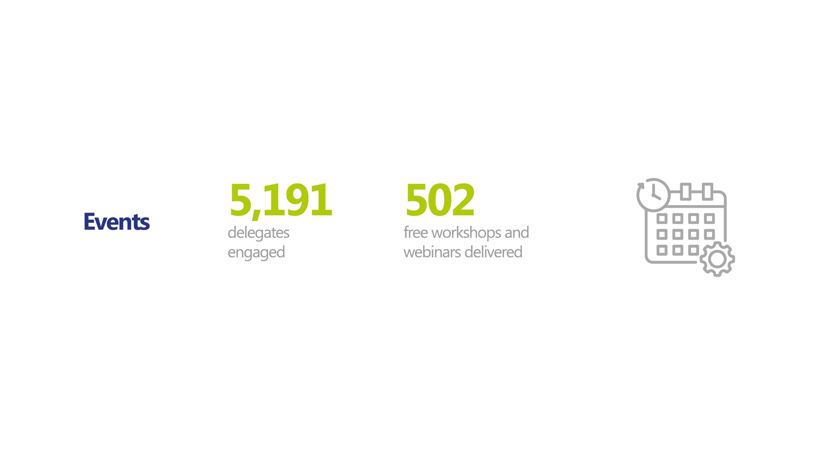
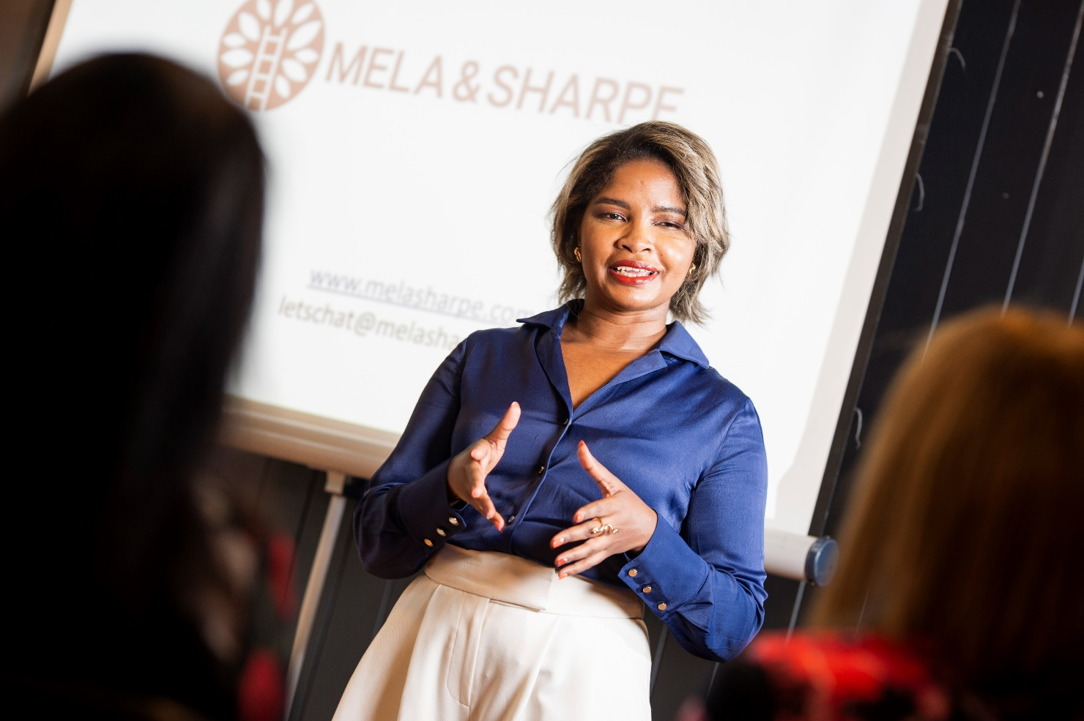
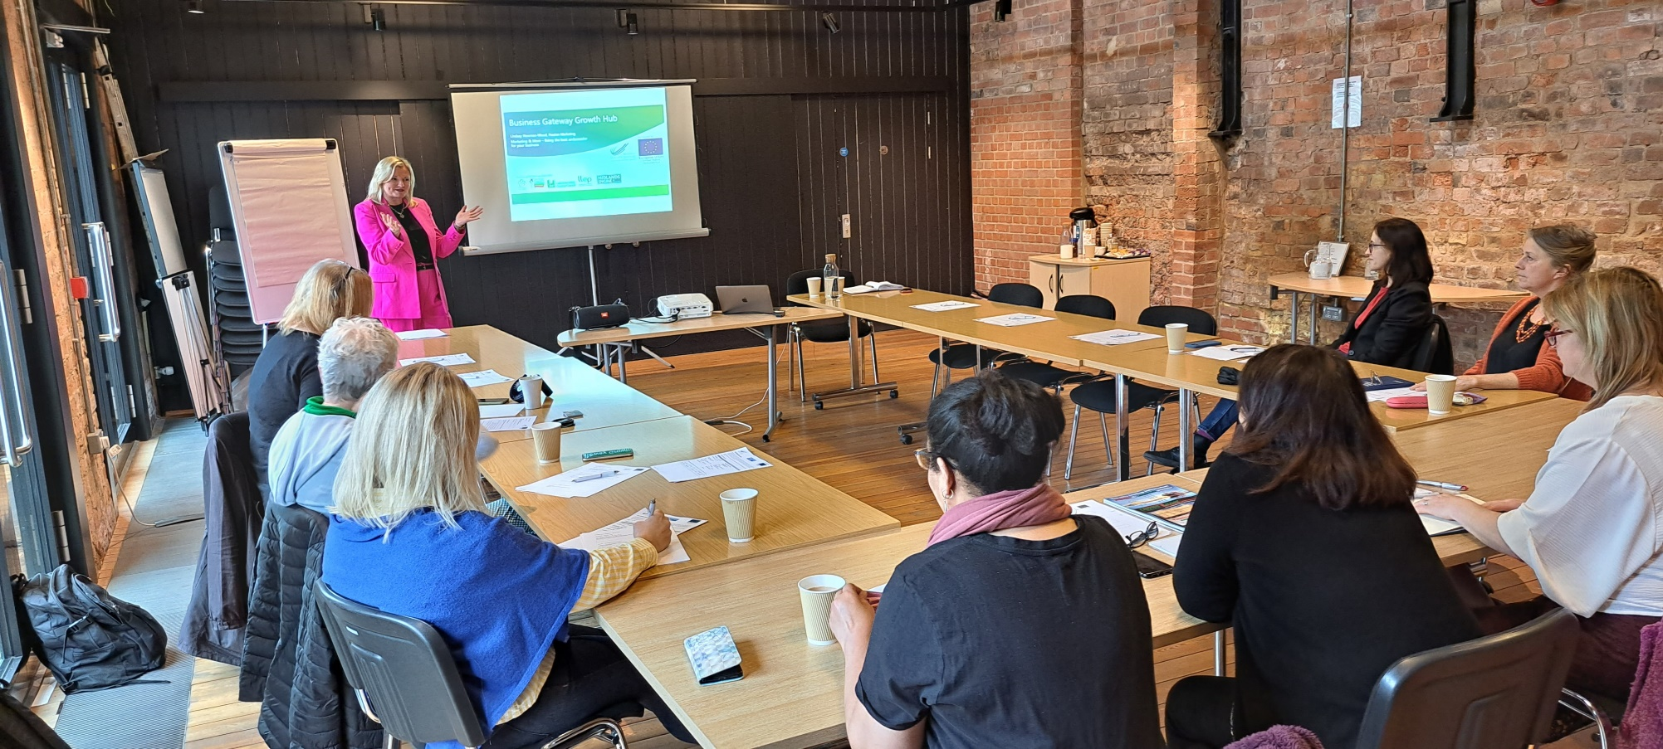
Events

Slide 9
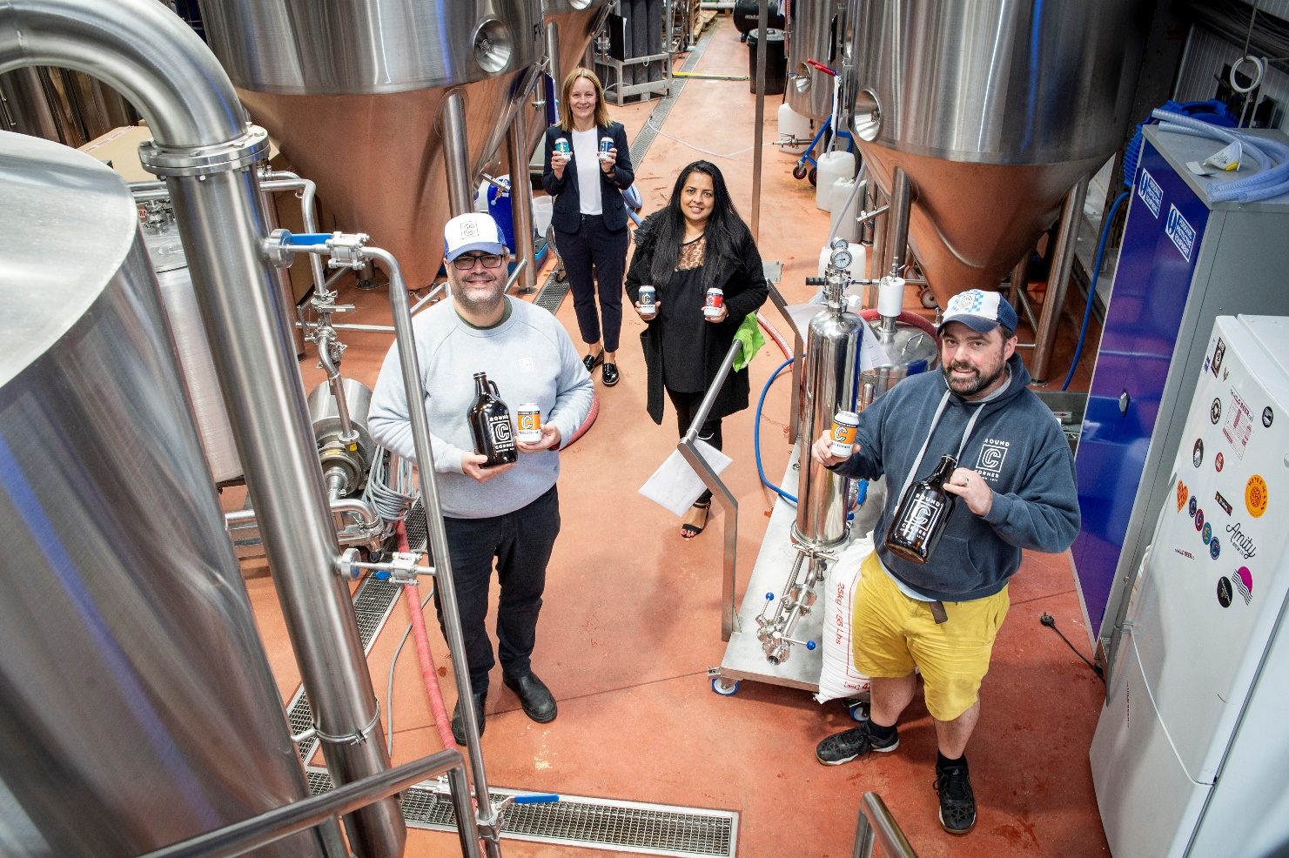
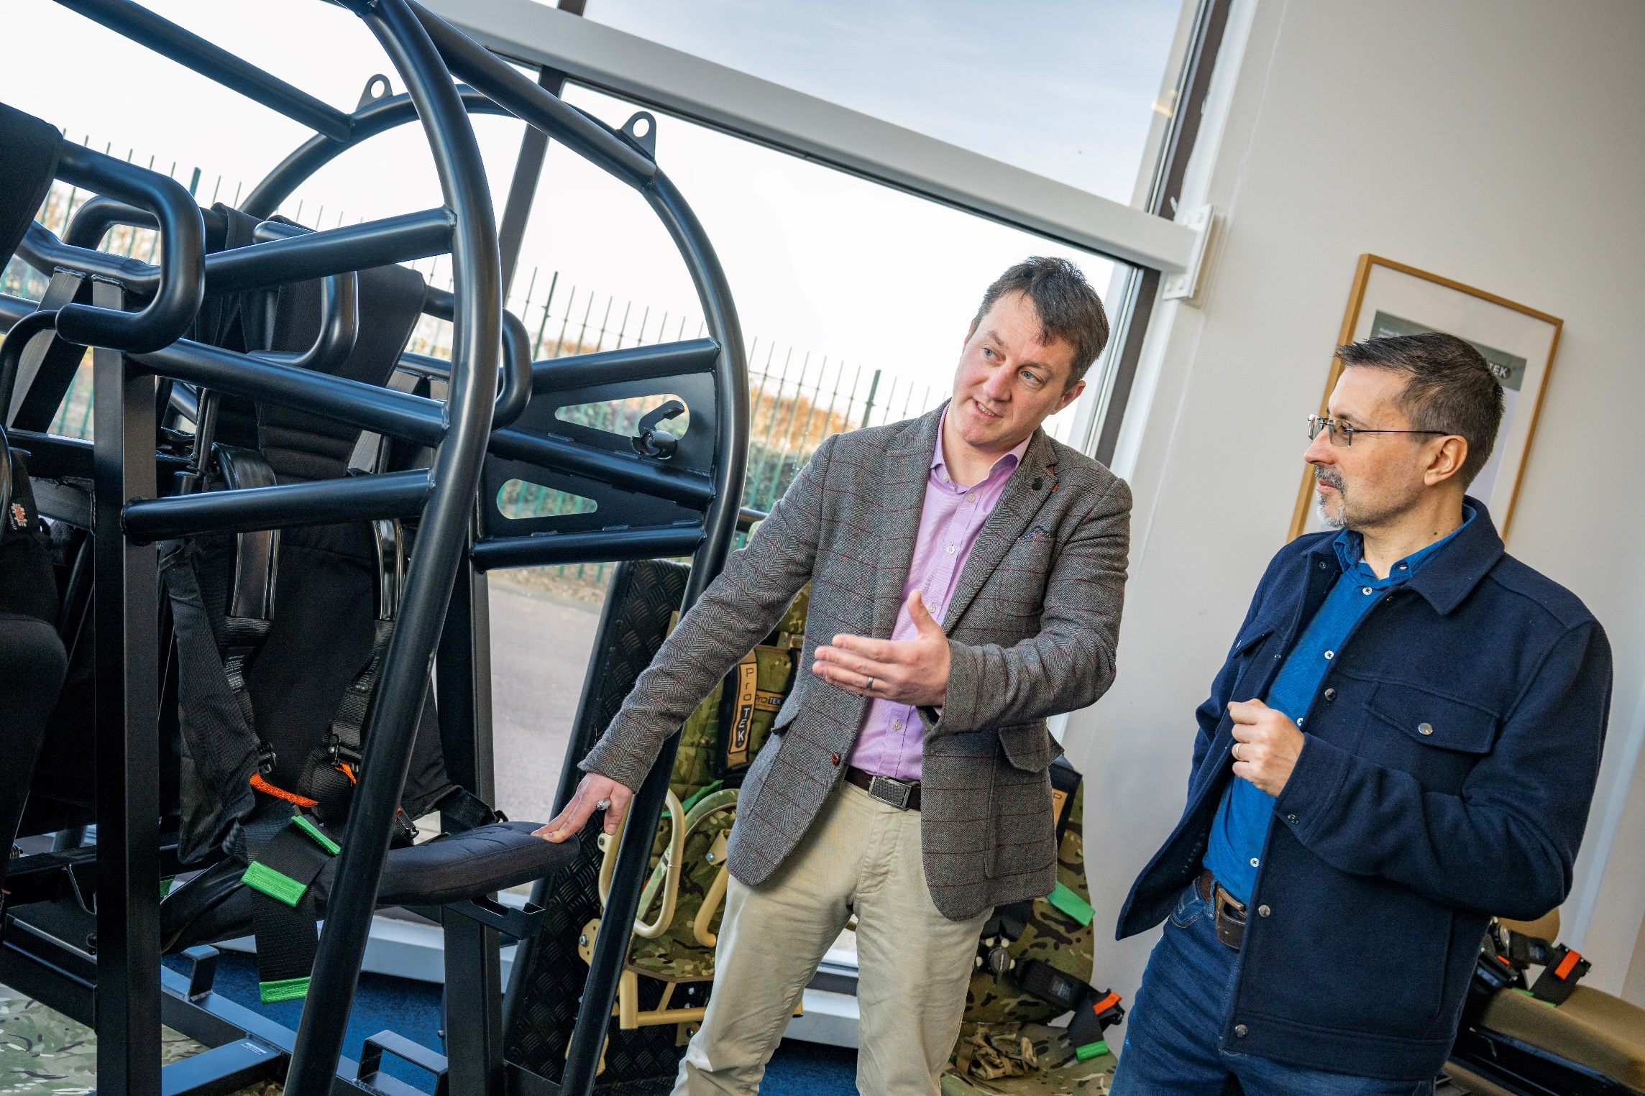
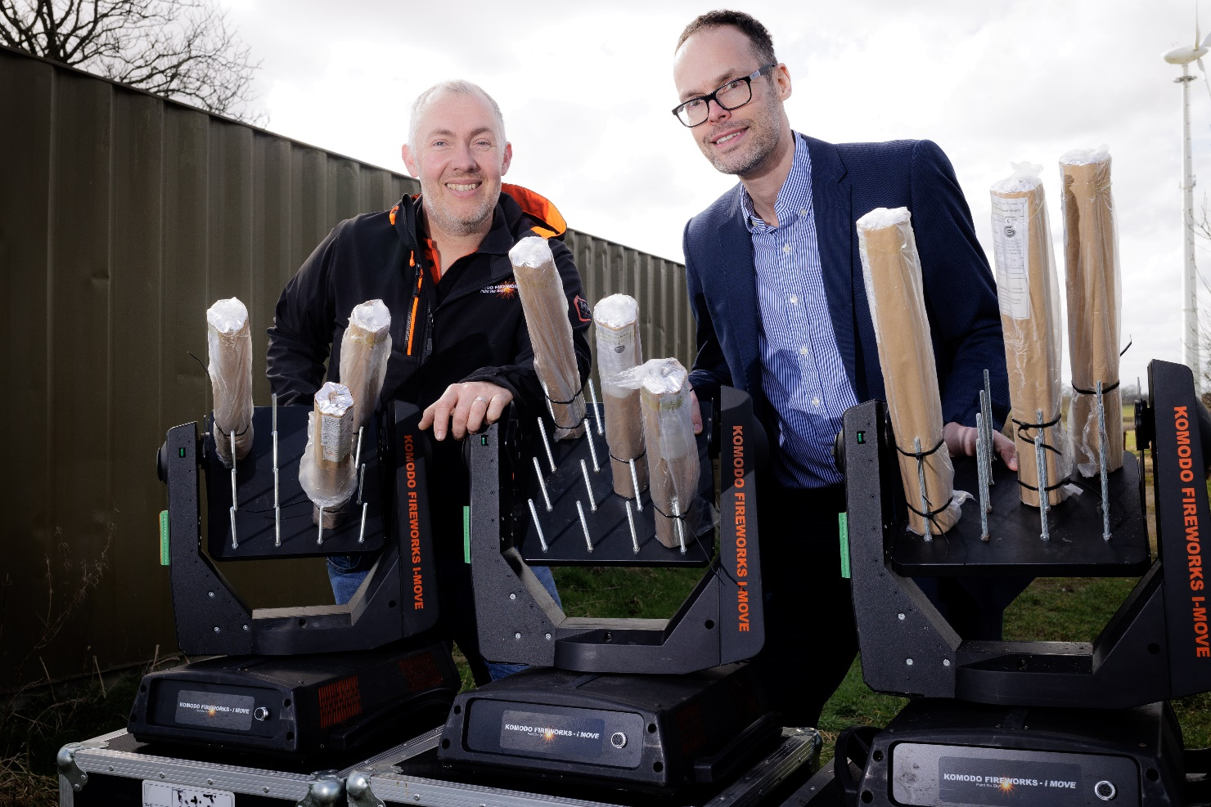
Grants

Slide 10
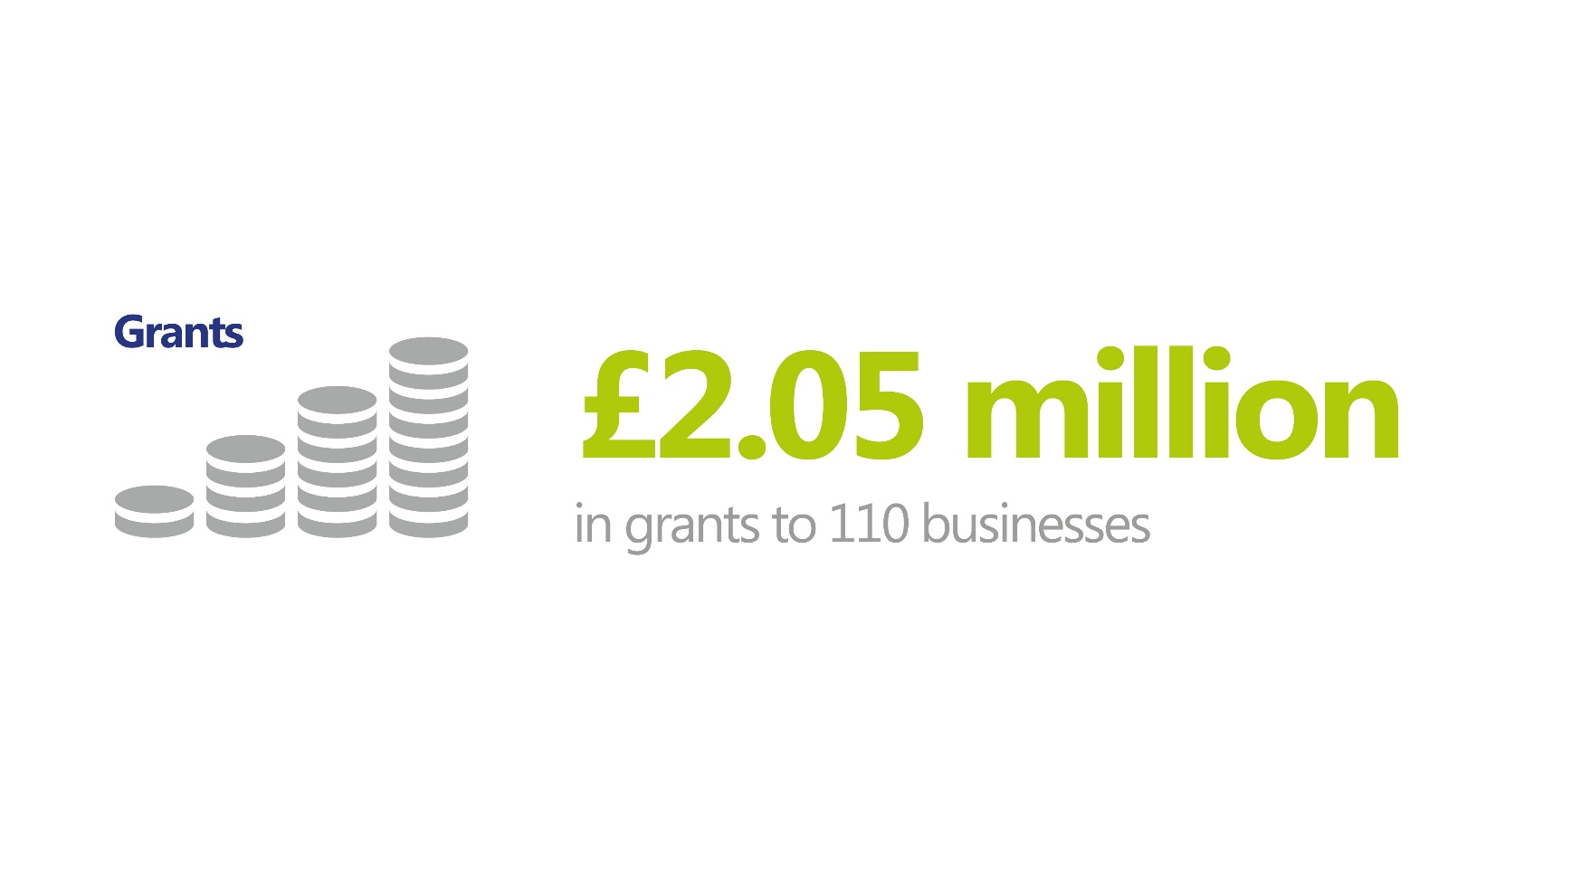


Grants
ERDF Growth Hub Grants
Business Investment

Slide 11



Other grants
ERDF Small Business Recovery Grants (DLUHC) £568k to 207 businesses
Business Support And Start Up Grants (LLEP) £300k to 145 businesses
Digital Technology grants (Chamber) - £2.1m to 211 businesses

Slide 12
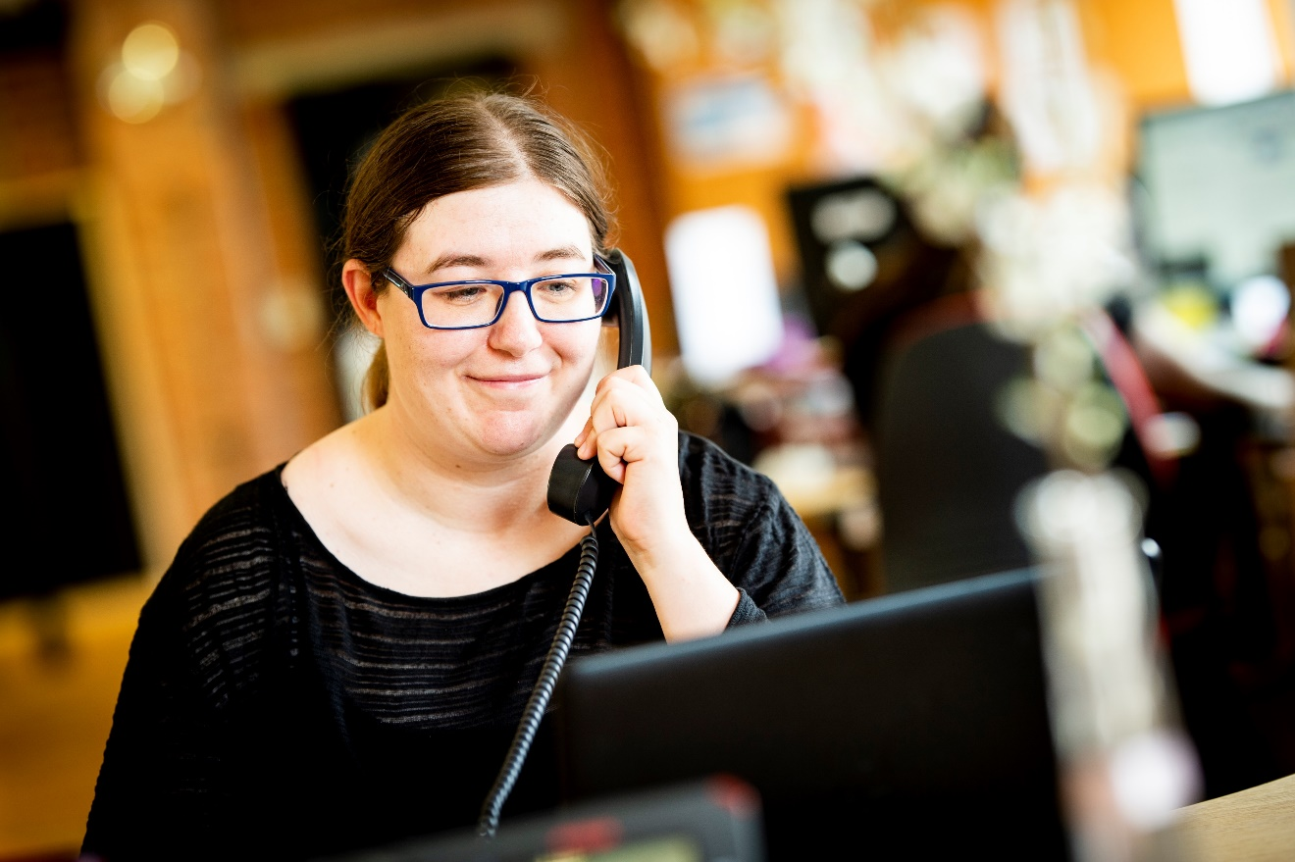
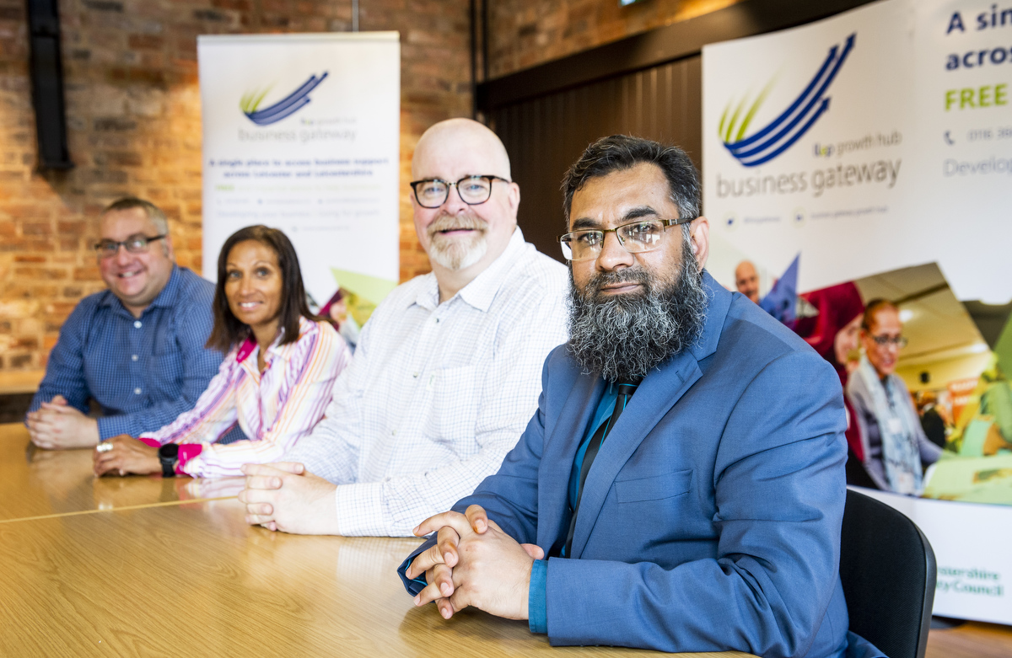
Support Programmes

Slide 13




Support Programme Highlights
Digital Business Growth Programme – 1912 businesses
Digital Upscaler – 238 businesses
Made Smarter – 150 businesses
Create Growth – 100 businesses
Notes:
Digital Growth Programme is a digital support offering access to grant funding, an array of awareness-raising seminars and strategic action-planning workshops designed to help SMEs embrace new technology.
Digital Upscaler – for High Growth Companies with the knowledge, investment and capacity to embrace new technologies this East Midlands wide programme has supported 614 businesses to date of which 238 businesses from Leicester and Leicestershire
Made Smarter – working in collaboration across the East Midlands More than 150 businesses have now applied for Made Smarter East Midlands – with two-thirds already going forward to the next stage. In excess of 100 eligible expressions of interest have been received since the programme launched in December....
Create Growth LLEP Growth Hub leading Creative Consortium with Derby Nottinghamshire and Lincolnshire programme to accelerate growth of businesses in the creative sector. Will support 100 creative businesses to scale, grow and become aby 2025

Slide 14



Support Programme Highlights
Ambition to Grow - 60 businesses
Peer Networks - 451 businesses
Start Up Business Support programme - 48 businesses
Notes:
Ambition to grow – programme of support to high growth businesses to identify their own unique barriers to growth and guide them through a dedicated programme of support
Peer networking (all years) - part of a national peer-to-peer networking programme for SME leaders wanting to grow and develop their business for future success
And the subs programme - providing intensive business support for start-ups, aiming to build resilience and help them achieve future investment readiness

Slide 15


Thank you

